Slide 1

Workflow thoughts
Andrew Grimshaw

Slide 2

Thoughts
There is a rich literature in workflow, workflow systems, workflow languages, etc. (There are even workshops)
Can either choose an existing solution (and anger everyone else), or create a new one.
Must clearly delineate between workflow/orchestration languages, implementations, and basic specification
OGF best served by simplicity – see success of JSDL
  Many existing systems are very capability rich
  Want something that is extensible – but captures just the simple part
Notes:
Acronyms:
JSDL = job submission description language
Adam:
Most of the existing solution have been designed without considering the grid environment in the first place. Often the workflow composition and
Workflow execution are tightly coupled which make them difficult to be used on in Grid based environment. Of course most of the
System can submit jobs on the Grid using Grid-middleware APIs, but still this is not a final solution, because most of the time the traffic
Of data has to go back to the client application, which make these solutions not feasible for Scientific workflow where large data sets
have to be processed and passed between workflow components. A couples of projects have developed workflow management system for the Old grid
paradigm such as Triana, ICNI, Askalon, VLAM-G, they are now moving toward OGSA but still they are at a very early stages.
When it comes to applying these system to real application, none of the existing system could be satisfy all the requirements of the applications we
are dealing with in the context of the VL-e project (High energy physics , food-informatics, Medical, Bio-informatics, Bio-diversity, tele-science). They only
choice we had is to support a number of workflow management systems which cover the requirement the 6 application domains
If now we consider that e-science applications, we have noticed that existing system are mostly focusing on the execution phase from the time a
workflow has to start to be executed, mostly no support is provide for the design phase and sharing of knowledge.
Zhiming Zhao:
In our view, scientific workflows in e-Science are a different guise of Problem Solving Environment. In different applications, workflow
management system(s) provide support for different levels issues: integrating distributed resources, present knowledge at different abstractions,
and hide underlying issues from high level etc. It is difficult to say one workflow system would cover all these issues. One of the research
direction we explore in VL-e project is to aggregate existing workflow management systems, which are developed at different domains or
for different purposes, as one meta system, called Workflow bus.

Slide 3
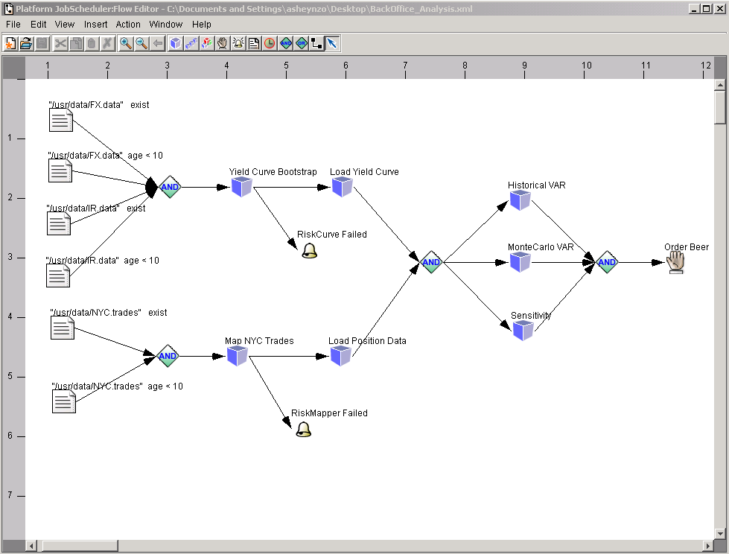
LSF Workflow Editor
Notes:
Acronyms:
LSF: Load Sharing Facility

Slide 4
Proposal
OGF/OGSA stay away from language and API specification
Create a simple Workflow description language (WFDL) that focuses on simplicity (everything else is out of scope) and that builds on (assumes) that the vertices are JSDL documents.
Don’t try for a WFDL that can do everything!!!!
Ensure that there are reasonable mappings from many existing systems to WFDL, i.e., it is possible to express some of their behavior in WFDL.
Others can build tools to construct and execute WFDL documents. The spec is silent on control structures, at most once semantics, and stuff like that.
Reuse as much proven spec as possible
Notes:
Acronyms:
WFDL = Workflow description language
JSDL = job submission description language
Adam:
There are already a couple of WFDL (MoML for kepler, SCuFL for Taveran, …….) and besides that we have the PBELWS proposed by IBM
Our experience show that indeed at this stage of e-Science application they require in most of the time very simple workflow patterns. And a simple WFDL
Should be able to handle most of the applications.
Victor:
(Yet another? Why not extend one and map it to the JSDL documents?)
Zhiming Zhao:
Workflows in an e-Science application can have different abstractions, Grid layer mainly deals the low level issues, e.g., data accessing/computing
tasks management. I am not against to have a new language, because anyway it will have to handle different issues than the other high level languages. But the point is how to make the mapping between the Grid level workflow language and high level abstract languages. Even you choose the syntaxes of an existing language, such mapping is still needed.

Slide 5
Model
WFDL’s are XML documents that describe directed graphs
  Vertices (nodes) and edges described
Nodes are either WFDL documents, or JSDL (or wrapped JSDL) documents
Nodes have labeled inputs and outputs
Edges connected outputs from one node to inputs on other nodes.
Question: Can the graph be annotated with information or initial “tokens”?
NB: Not data flow. Some “outputs” may simply be that an event has occurred.
Notes:
Acronyms:
WFDL = Workflow description language
JSDL = job submission description language
Adam:
Graph annotation is now also become more and more popular, most of the approaches are trying to add semantics to validate the workflow
before It is run and also search for existing workflow to increase reusability.
=================================================================================================
Victor: (XML documents that describe directed graphs)
Because most Workflow Management System (WMS) use their own graphical notations, it is challenging to take advantage of the
standardized constructs to build a visual representation of process and services descriptions. The dynamic nature of workflows causes
the collaboration to evolve at the different stages, including those of formulation, composition, execution, monitoring, and evolution.
The human interpretation of the workflow, therefore, gradually develops over the time. Thus, the level of detail (and format) of a graphical
representation of the workflow may vary then according to the expert and the stage in the life cycle.
Current graphical front-ends to represent workflows are either static (no allowing manipulation of element), or dynamic. Taverna and Kepler
represent examples of static front-ends, Teuta and VLAM-G typify dynamic front-ends. The current front-end tools, however, do consider yet
the detail level, the different audiences, or the positioning of the elements in diagrams, which make it very difficult, and in some cases impossible,
to provide a human-readable graph.
If employing both language and GUI model to describe a workflow, the challenging issue of synchronization between the two arises.
The problem refers to maintain the language representation and diagram synchronized, in the sense that any modification to one is propagated
to the other. Alternatively, it is possible to employ a single workflow language extending it with graphical descriptions.
=================================================================================================
Zhiming Zhao
A proper workflow model is abstracted from the characteristics of components and the dependencies between them. Before
we say what is a suitable model for WFDL, e.g., DAG, Petri net or what ever another one, we have to distinguish what are the
unique issues OGSA level workflow engines have to handle? If it is similar to a normal WS based workflow, results from Taverna
or Triana for composition can be reusable here.

Slide 6
Notes:
Adam:
Indeed the Workflow engine boils downs to manage dependencies still data dependencies are the most common
Zhiming Zhao:
Orchestrating the runtime behavior of involved resources, including human activities, are an important function of workflow
engines. How to support human in the execution loop of a workflow makes the design of engine different: submitting
without changing, or manipulating while it is executing. Of course, at its most underlying level, managing dependencies is the key issue.

Slide 7
Notes:
Adam:
I do agree with the fact that programming model has to be outside the scope of OGSA. OGSA should provide the Support to allow the development
Of Grid-enabled workflow engines. The experience we have had last year with developing the WS-VLAM (data driven workflow engine) suggested
That it is already possible.
Zhiming Zhao:
I agree it in half. In a workflow, OGSA can not only be a underlying service to realize workflow engine, but also itself can be a resource to being coordinated by a workflow. The interface of OGSA services and invocation do have influence on the development of programming model.

Slide 8
Notes:
Adam:
That is correct to be able to provide a framework to do real Science on the Grid. It is important to decouple the workflow engine which
Orchestrate the workflow execution from the client application used to compose, submit, eventually monitor the execution of the workflow
And interact with the workflow to changes some steps based on some results. Experience showed that the requirements may
not be complex but the factor human in the loop is quite widely required.
Zhiming Zhao:
To serve as an infrastructure for e-Science application, Grid services which can allow high level workflows to execute transparently
on Grid is crucial. A clear requirement study on different existing workflow engine implementation is important to provide proper
services which can help those workflow systems move to Grid.

Slide 9
Notes:
Adam:
OGSA should provide the basic services, the workflow engine can use to orchestrate the workflow execution. En example of this basic service
Is the delegation service, which can be used to find the appropriate Grid credential to submit a workflow component on a particular resource.
Zhiming Zhao:

Slide 10
Notes:
Adam:
OGSA should provide as usual basic services that makes the life of workflow engine easier on the Grid
Zhiming Zhao:

Slide 11
Notes:
Adam:
Good for us, this might help in finding the basic services which can help us in the design of a better workflow for grid system

Slide 12
Notes:
Acronyms:
JSDL: Job Submission Description Language
BES: Basic Execution Service
RSS: Resource Selection Service
Adam:
One way to do this is to implement the workflow engine as a WS-RF Service (see attachment WS-VLAM)

Slide 13
Notes:
Adam:
If OGSA will have to be extend to support workflow engines, it might be a good idea allow the description of job or task
dependencies (data or others). Dependencies means different workflow orchestration (data driven Synchronous Data Flow
and Process Networksb or control driven Discrete Event (DE)

Slide 14
Notes:
Acronym: OGSA EMS (Execution Management Service)
Adam:
- Will read about it I don’t the details of OGSA EMS
- A good exercise for us is to try to see if we can describe the WS-VLAM engine in terms of the OGSA EMS
Fundamental Job Execution (requires an up and running BES)
Direct Job Execution
in the current implementation of the WS-VLAM we use the GRAM and WS-GRAM as BES
(see activity diagram of the WS-VLAM presentation slide No XXX)
Indirect Job Execution
I think the WS-VLAM engine is exactly the job manager described in OGSA™ EMS Architecture Scenarios
Version 1.0 (draft 017). (see activity diagram of the WS-VLAM presentation slide No XXX)
Job Termination
In the current implementation of WS-VLAM the user agent subscribes to event generated by the EBS, and WS-VLAM engine
(the WS-VLAM engine) do a kind of polling to find out if activities are still alive or dead)
Selected Job Execution (Execution Planning Service (EPS) )
The WS-VLAM engine uses the Resource Manager (which should be equivalent to the Execution Planning Service (EPS)
to select a BES container
Deployment and Configuration
We did start in the context of the VL-e project the design of an architecture which should allow the deployment of software component
on demand (www.science.uva.nl/~adam/courses/master-thesis/vincent_B.pdf )

Slide 15
Notes:
Adam:
We are currently looking at a WorkflowBus, which should allow the interoperability among various Workflow management
systems. A sort of Meta workflow engine which coordinate the execution of a workflow using a number of workflow engines
Zhiming Zhao:
Victor:
What about semantics? Do you plan to study and comparing different approaches to WF semantic description?
A mechanism based on the OGSA is needed for semantic discovery

Slide 16
Notes:
Adam, Zhiming:
Shall we Volunteer or maybe go to the next OGF in Manchester to meet these guys?

Slide 18
Notes:
Adam:
Agree

Slide 19
Notes:
Adam:
Cycle’s might be needed by makes things more complicated should be avoided at this stage. Most of the workflow management systems support only DAG Anyway.
Do you mean, control flow elements? If yes, I guess there are often needed most of the e-science find them useful

